Slide 1
Windows 10 Module 4
Using Apps to Get and Share Information

Slide 2
Module Objectives
Browse the web with Edge
Search the web
Manage web results
Add contacts to People
Send messages with Mail
Receive and respond to messages
Use instant messaging
Manage events with Calendar
Store information on OneDrive

Slide 3
Browse the Web with Edge
The Internet is a global collection of computers linked together to share information
The web (World Wide Web) is part of the Internet that consists of websites
  Website: Contains web pages linked together
  Webpages: Specially formatted documents
  Web browsers: Software used to surf the web
  Web address (URL): Internet location of webpage
Microsoft Edge is the default web browser for Windows 10

Slide 4
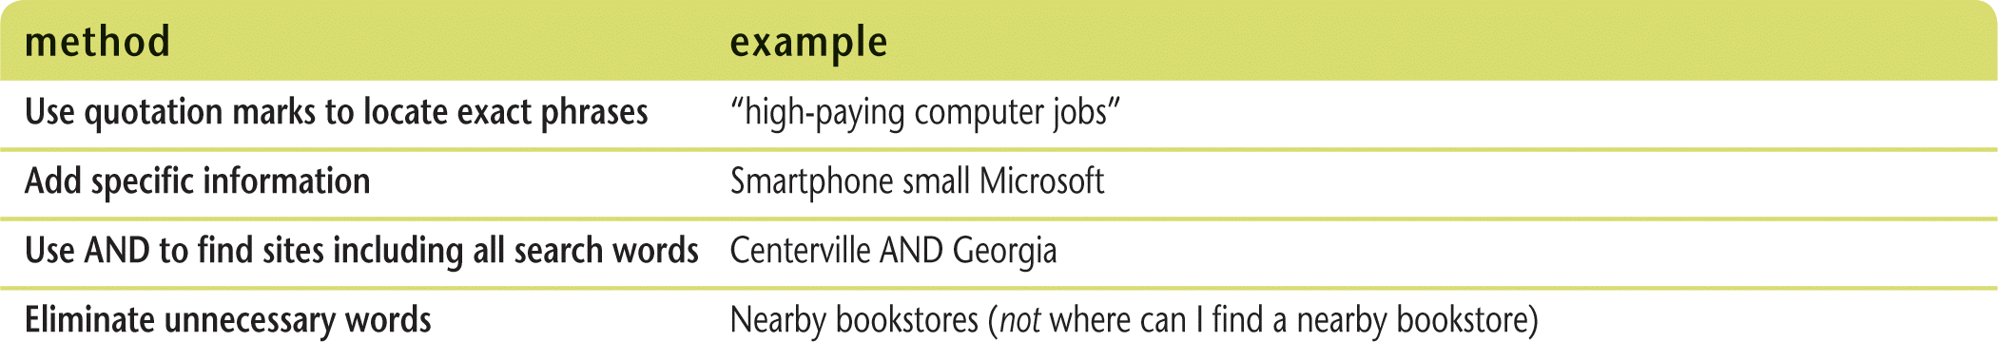
Search the Web (Slide 1 of 2)
A search engine is a program that searches Internet information to find what you want
Keywords are the words or phrases you submit to the search engine
Hits refers to the search results
Ways to narrow search results

Slide 5
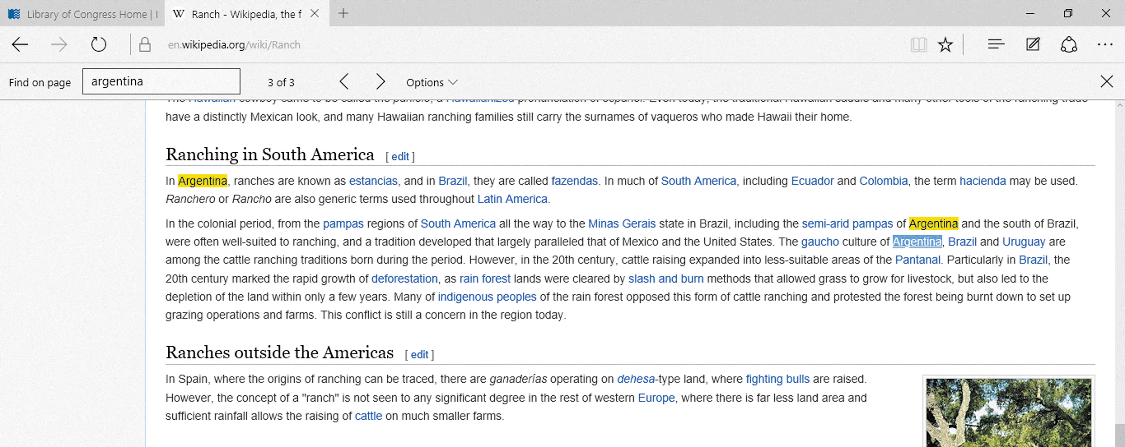
Search the Web (Slide 2 of 2)
Using Find on page to locate occurrences of “argentina”

Slide 6
Manage Web Results (Slide 1 of 3)
Microsoft Edge tools
  Bookmark
  Favorites list
  Reading list
  Hub
  History list
  Downloads list
  Web Notes
    Can annotate pages including pen or highlighter markings
Reading view
  View webpages without advertisements of unnecessary content

Slide 7
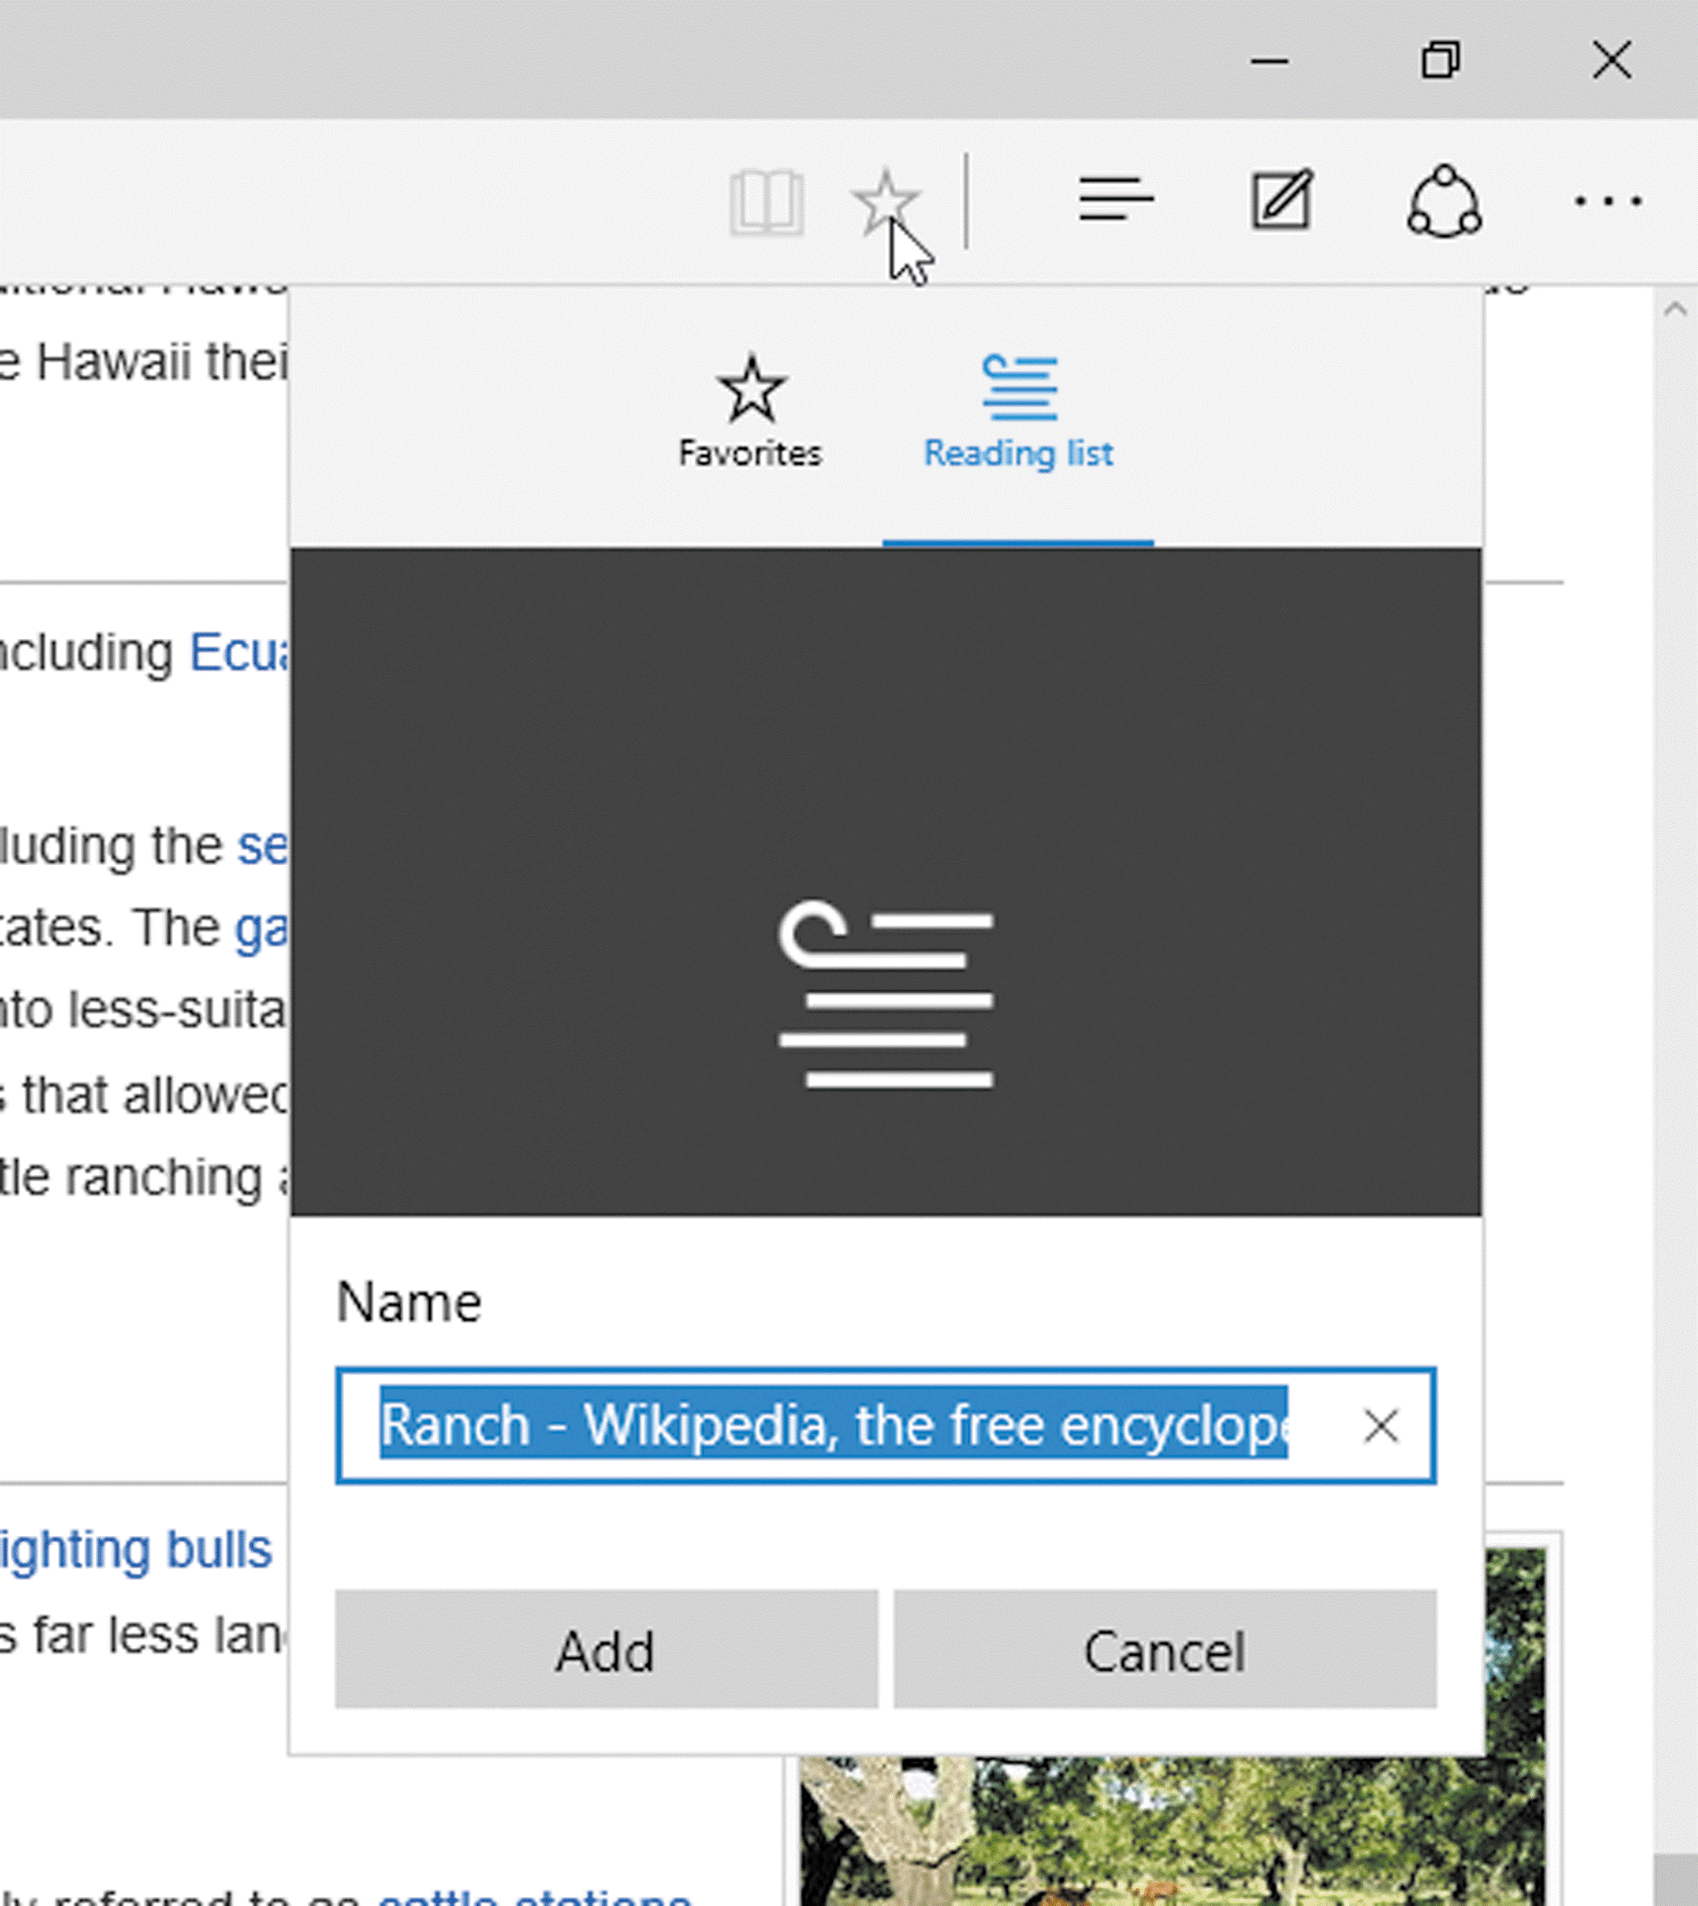
Manage Web Results (Slide 2 of 3)
Adding a site to your Favorites or Reading list

Slide 8
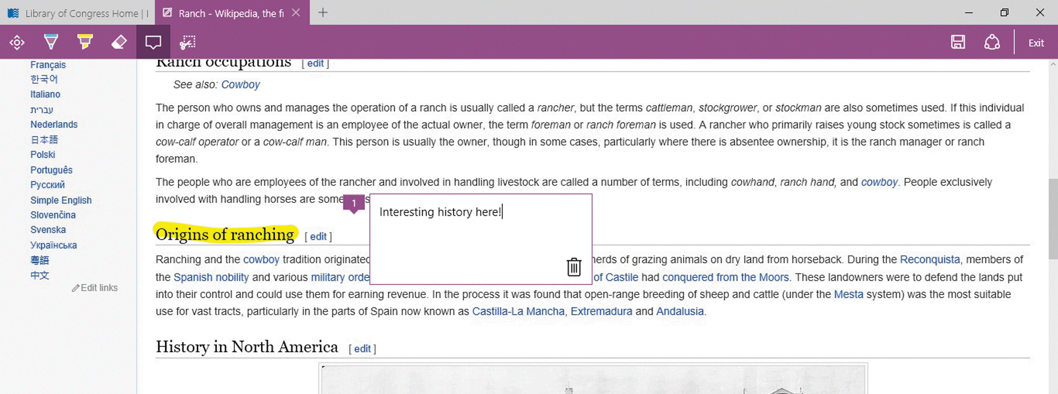
Manage Web Results (Slide 3 of 3)
Annotated webpage

Slide 9
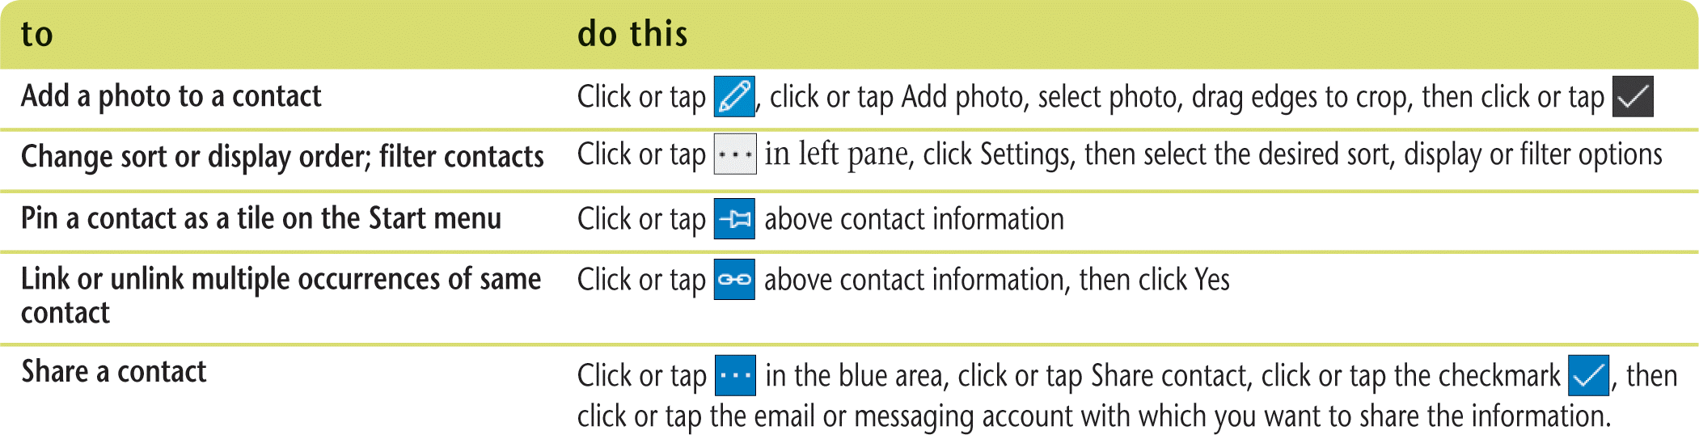
Add Contacts to People (Slide 1 of 2)
A contact is a person or company with whom you communicate
Windows 10 uses the People app to manage contact information
  Create contacts
  Add contacts from online accounts such as Outlook, Twitter, and Skype
  Additional People app tasks

Slide 10
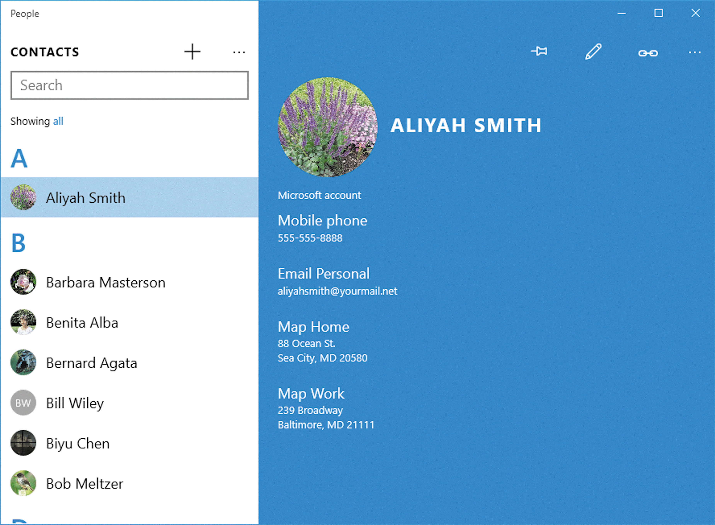
Add Contacts to People (Slide 2 of 2)
People app with highlighted contact

Slide 11
Send Messages with Mail (Slide 1 of 2)
Windows includes a Mail app to manage email (electronic mail)
Email messages follow a standard memo format
  To
  Subject
  Typed message
Can send a copy of your message to additional recipients
Can add attachments
Works with the People app to find recipient names

Slide 12
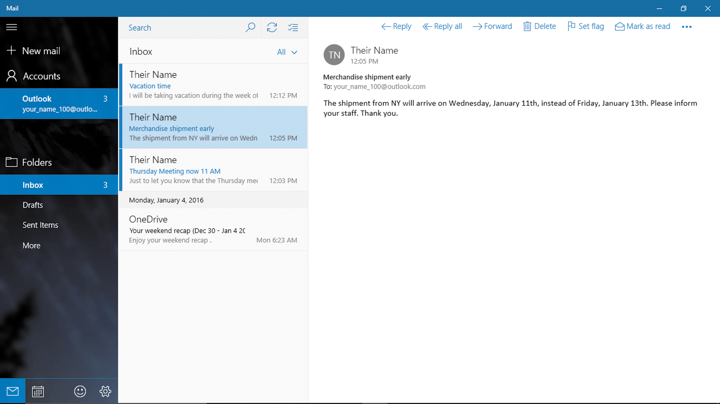
Send Messages with Mail (Slide 2 of 2)
Mail app

Slide 13
Receive and Respond to Messages (Slide 1 of 2)
The Mail app checks for messages
  When you open the app
  Periodically while the app is open
  When you press the Sync this view button
When you respond to messages
  Reply to create a new message to the sender
  Forward to create a new message for someone else
Spam, unsolicited mass email, is placed in the Junk folder

Slide 14
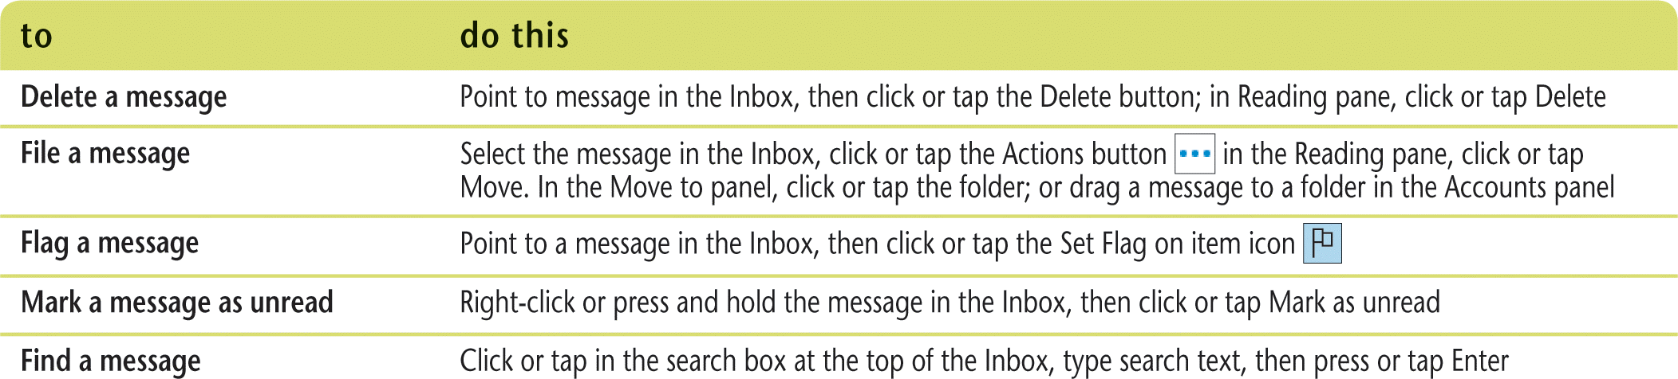
Receive and Respond to Messages (Slide 2 of 2)
Can attach a file to an email message
Mail response actions

Slide 15
Use Instant Messaging
Messaging is an instant message app
An instant message is an online typewritten conversation in real time
A conversation of text exchanges is called a thread
Integrated with Skype Video
  Talk and see another person in real time
  Create a Skype account at www.skype.com

Slide 16
Manage Events with Calendar (Slide 1 of 2)
Calendar app allows you to manage events on your calendar
  Schedule tasks, appointments, meetings, vacations, holidays, or other activities
  Switch between multiple formats: Day, Week, or Month
Comes with calendars for different purposes (each calendar uses a different color)
  Main
  Birthday
  Personal
  Holidays
  Work

Slide 17
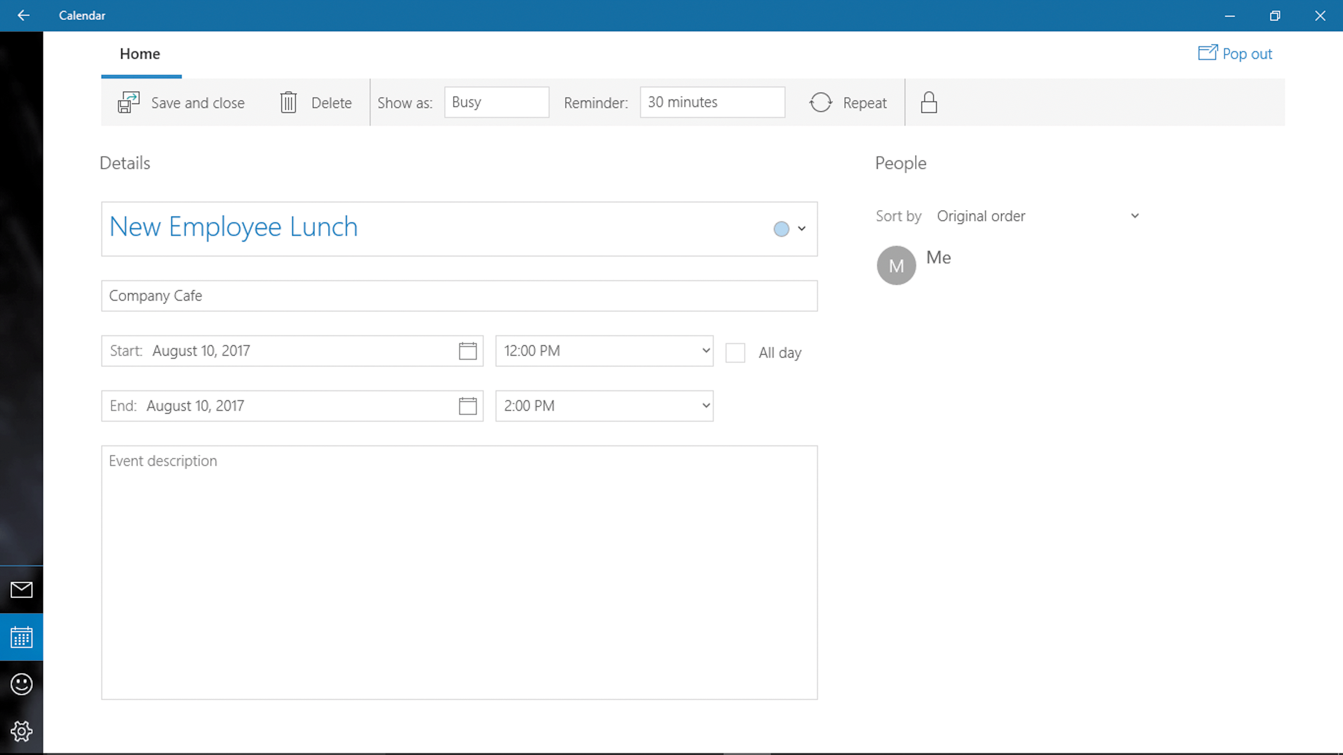
Manage Events with Calendar (Slide 2 of 2)
New Calendar Event screen

Slide 18
Store Information on OneDrive
OneDrive is an online file hosting service
  Upload files
  Sync files
OneDrive can be accessed easily
  OneDrive app in Windows 10
  Web browser
  Mobile device
Can organize your files in folders
Provides access to Office Online
  Word, Excel, PowerPoint, and OneNote

